Slide 1

Dallas Crime - Data Analysis
By: Sam Heidler, Ranjana Suresh, Skye Cao

Slide 2
Introduction
Purpose:
To investigate trends in crime within large cities to inform policy-making aimed at reducing crime rates.
To compare crime in a Northern (Baltimore) vs. a Southern (Dallas) city.
Why Dallas and Baltimore?
Dallas and Baltimore are large cities (250,000 people or more) with similar crime rates (497.9 and 366.5 crimes committed per 100,000 people, respectively). Both cities also have an extensive database of crime information to use for the comparison.
Datasets:
Arrest data for Dallas, TX and Baltimore, MD
From city police departments
Time/place of arrest
Involvement of weapons in crime
Demographic info of arrestees
Dallas (2014-2022): 60,000 observations, 18 variables
Baltimore (2011-2016): 260,000 observations, 11 variables

Slide 3
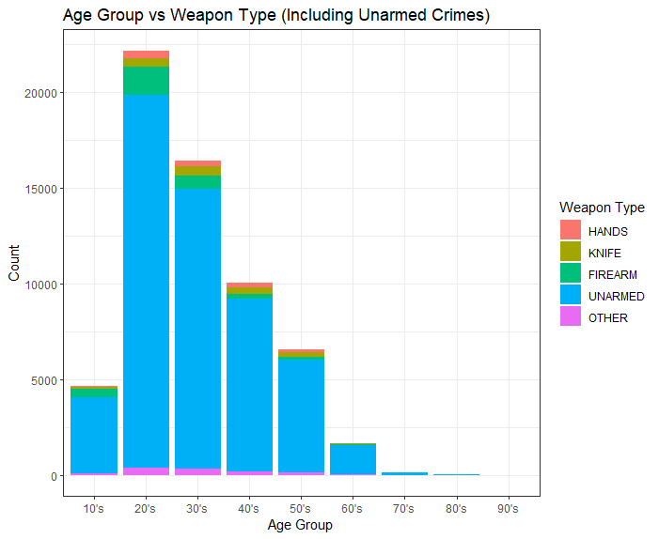
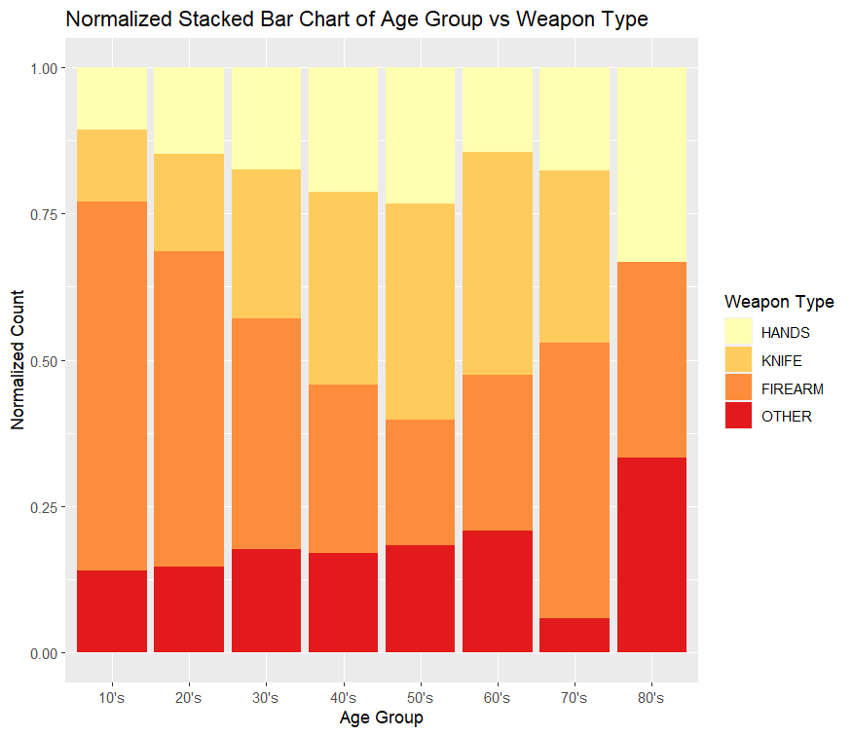
How do the instances of weapon-related crime vary by age group in Dallas?
Majority of crimes did not involve an armed arrestee.
Firearms are the most popular weapon for arrestees in their teens and 20s.
Arrestees in their 40s-60s have slightly higher rates of knife use compared to firearms.
Firearms and hands are more popular weapons for older arrestees (70s-80s).

Slide 4
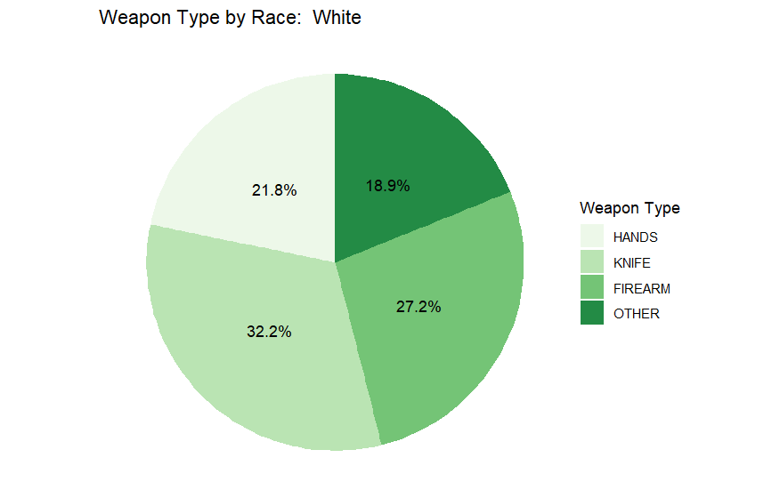
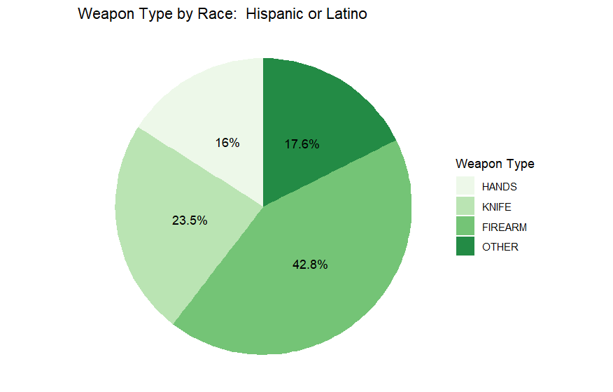
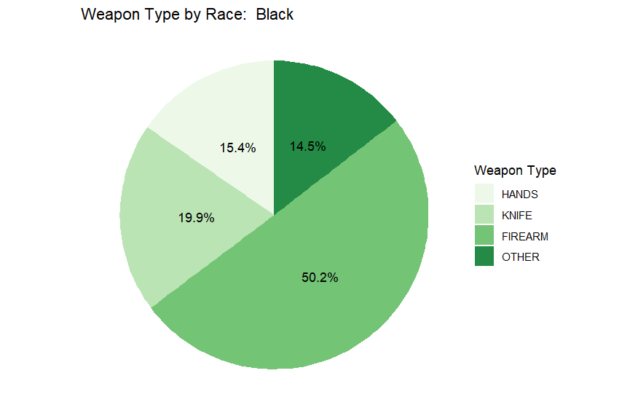
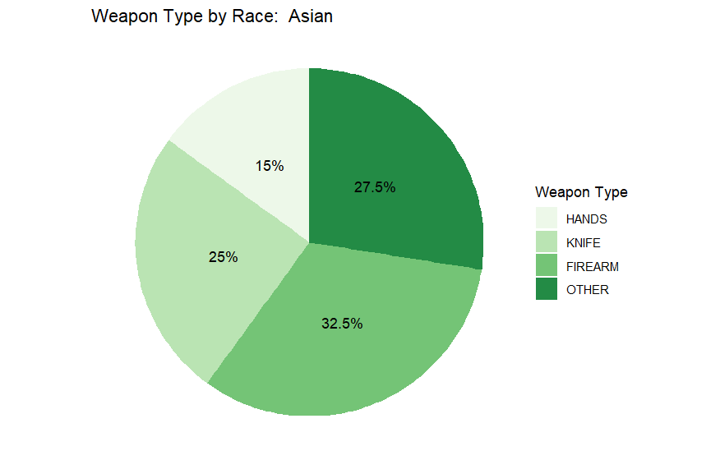
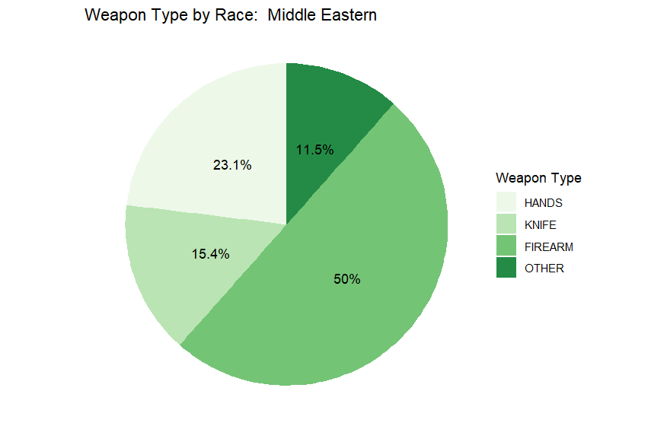
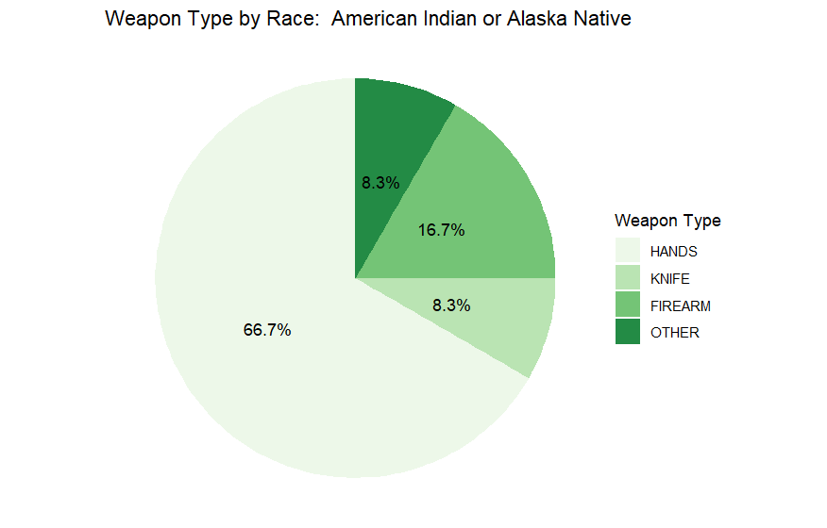
How do the instances of weapon-related crime vary by race in Dallas?
Firearms are the most popular weapon for most racial groups, followed by knives.
White arrestees possessed knives slightly more than firearms.
American Indians and Alaskan Natives use their hands as weapons about two-thirds of the time.

Slide 5
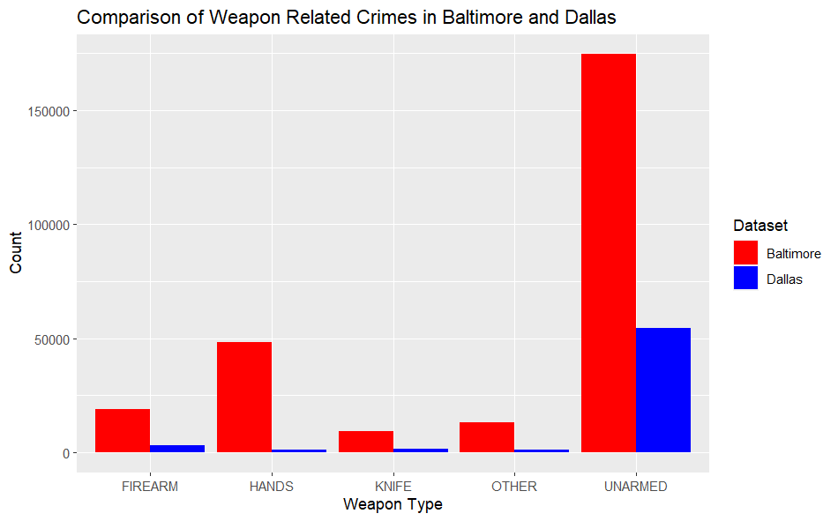
How do instances of weapon-related crimes compare between Dallas and Baltimore?
This visualization compares raw data for generalized weapon types in arrest data for two cities.
Baltimore has higher crime rates (number of crimes per 100,000 people), resulting in more data for all columns.
Baltimore population:
576, 298
Dallas population:
1.288 million

Slide 6
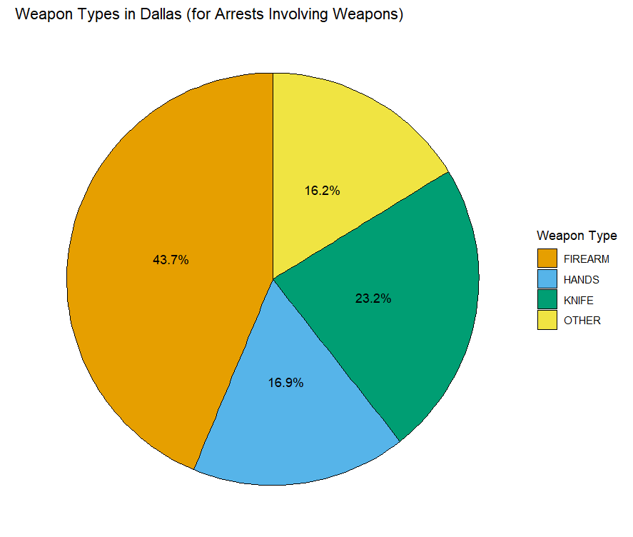
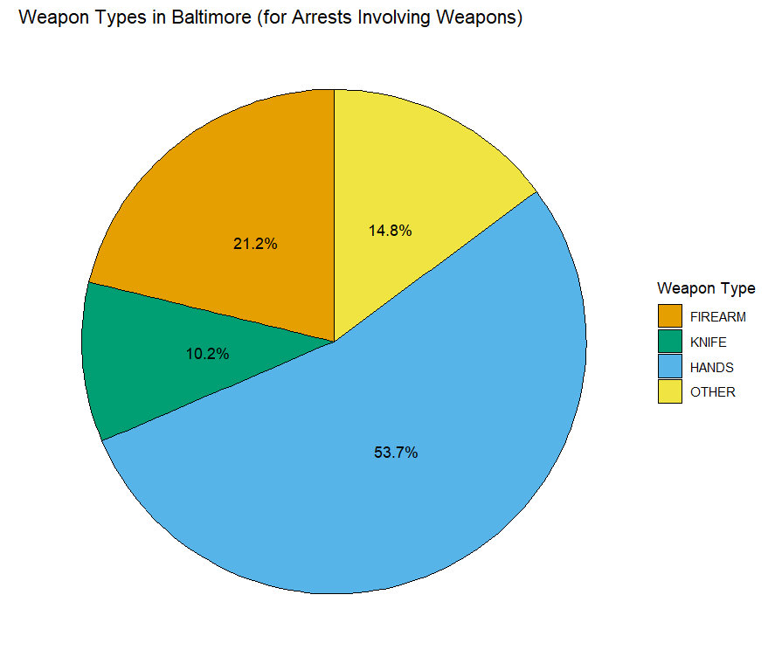
How do instances of weapon-related crimes compare between Dallas and Baltimore? (Continued)
In Baltimore, slightly more than half of weapon-related crimes involved the use of hands, while in Dallas only around 16.9% did.
Firearms were the most commonly used weapon in Dallas, but they were only the second most common weapon in Baltimore.
May be due to stronger gun restriction laws in Maryland vs. Texas

Slide 7
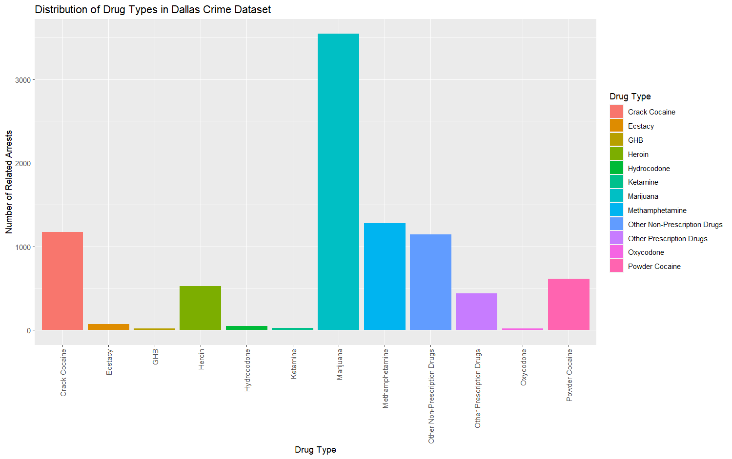
Data Analysis of Drug-Related Crime (Dallas)
Marijuana was by far the most commonly involved drug in drug-related arrests in Dallas.
Meth, crack cocaine, and various non-prescription drugs were the next most commonly involved drugs.

Slide 8
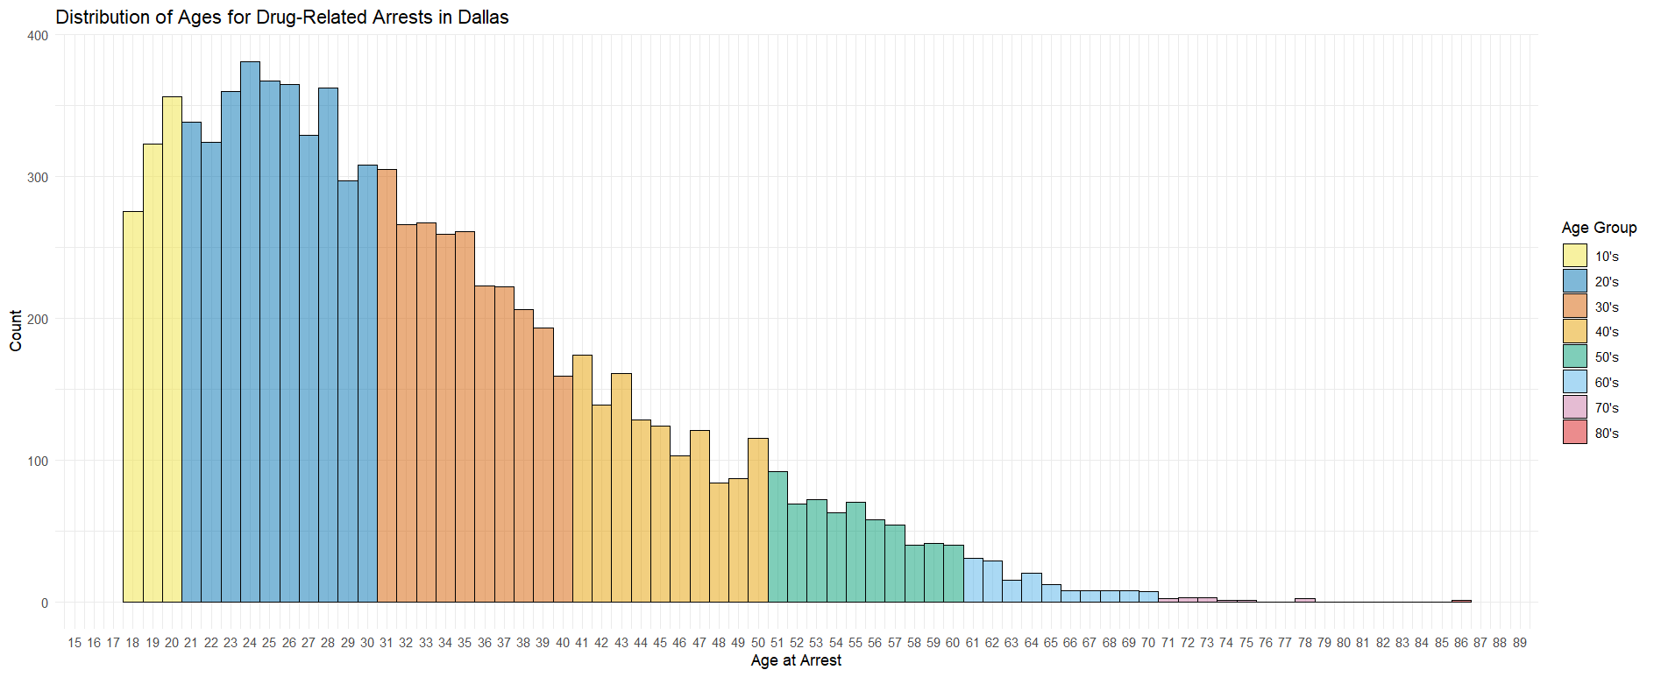
Data Analysis of Drug-Related Crime (Dallas)
Right skewed distribution of drug use/arrests vs age among Dallas residents

Slide 9
Limitations
Some factors may explain higher crime rates in Baltimore vs Dallas:
Baltimore is a much denser city than Dallas (at 7594 vs. 3870 people per square mile)
Median household income for Baltimore is $54,124 compared to Dallas's $58,231 despite cost of living in Baltimore being 13.9% higher.
Poverty rate of 17.7% in Dallas vs 20.3% in Baltimore.
May want to compare cities with more similar population densities and economic circumstances for future work.

Slide 10
Future Work
Investigate how instances of drug-related and weapons-related crimes have changed in recent years in both Dallas and Baltimore.
Compare the weapons-related arrest data from Dallas to other cities to see if the high involvement of firearms is unique to Dallas, or to a larger region (like Texas or the South).
See if there are any patterns between demographic data and drug related crimes in Dallas:
Which age/race groups were most likely to be arrested for drug-related charges?
What types of drugs are commonly associated with different age/race groups?
Figure out if there is any correlation between the number of arrests in Dallas during a certain year and the population, or if major events (like the COVID-19 pandemic) affected the number of arrests.

Slide 11
References
Baltimore, MD, Crime Rate & Safety | U.S. news best places. U.S. News. (n.d.). Retrieved April 1, 2023, from https://realestate.usnews.com/places/maryland/baltimore/crime
Baltimore Police Department, August 21, 2016, Baltimore Crime Data, data.world, https://data.world/baltimore/baltimore-crime-data.
Bureau, U. S. C. (2023, January 25). City and town population totals: 2020-2021. Census.gov. Retrieved April 9, 2023, from https://www.census.gov/data/tables/time-series/demo/popest/2020s-total-cities-and-towns.html
Compare state gun laws. Everytown Research & Policy. (2022, January 20). Retrieved April 9, 2023, from https://everytownresearch.org/rankings/compare/?states=TX%2CMD

